Slide 1
Do the Hot Springs Affect Water Quality?
Macro-Invertebrates as Indicators of Water Quality
By: Lizzie Bowden

Slide 2
Background
Macro-invertebrates originally used as indicators of water quality
More accurate than chemical tests – 24/7, 365 days a year

Slide 3
Macro-invertebrate species
High Water Quality Indicators: Mayfly & Stonefly
Indicate good water quality
Thrive in high levels of oxygen
Stonefly

Slide 4
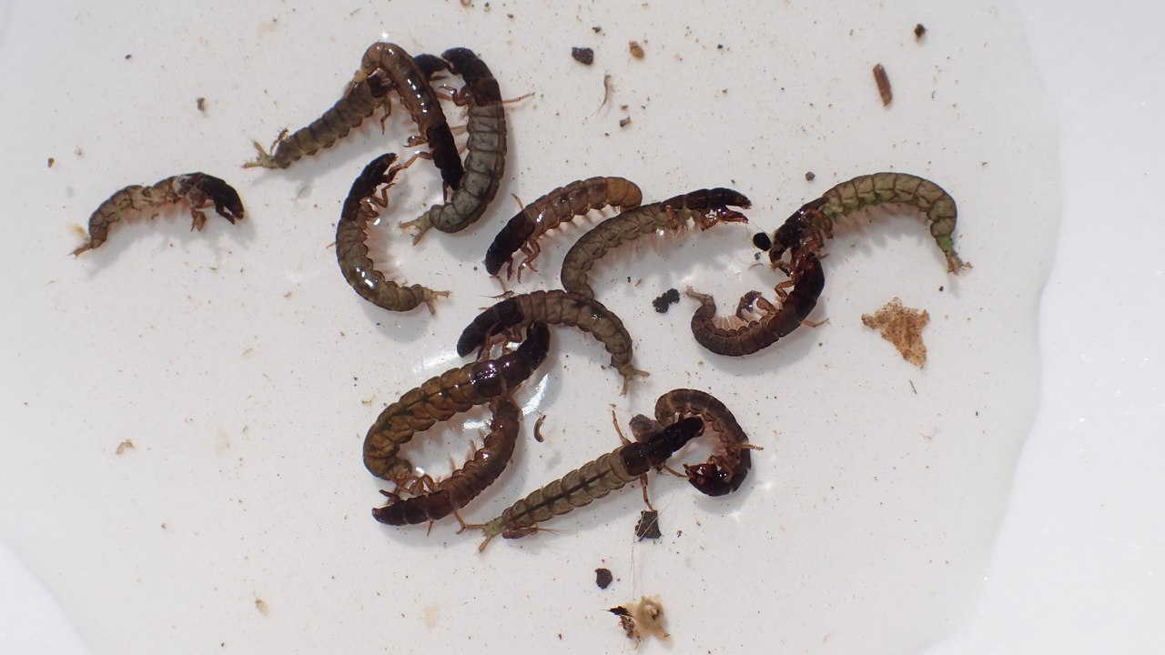
“Neutral” Water Quality Indicators
Invertebrates that do not indicate high or poor water quality
Fly larvae
Caddisfly

Slide 5
Poor Water Quality Indicators
Red pigmented worms
Species adapted red hemoglobin to survive in low-oxygen water

Slide 6
Hypothesis
High water quality invertebrate indicators will be abundant in cold water farthest from the hot spring. Poor water quality indicators will be found in warmer waters near the hot spring.

Slide 7
Materials
Camera
4 different locations with varying temperatures
Thermometer
Macro-invertebrates
Bags
Net
Containers
Microscope
Pipette

Slide 8
Method
1.Collect macro-invertebrates from various locations
2. Identify and organize species
3. Count number of each species found in each location
4. Analyze and compare data

Slide 9
Location #1: Hot Springs
Temperature: 76 degrees

Slide 10
Location #2: Warmer River near Hot Spring Temperature: 78 degrees
Location #3: Colder River near Hot Spring Temperature: 64 degrees

Slide 11
Location #4: Rio Cotito
Temperature:62 degrees

Slide 12
 | Table 1: Number of Individual for Each Group of Macro-invertebrates
 |  | Cotito River Below | Warm River by Hot-Spring | Cold River near Hot-Spring
1 | Stone Fly | 13 | 2 | 15
2 | May Fly | 67 |  | 12
3 | Beetle Larvae | 1 |  | 2
4 | Damsel Fly Larvae |  | 2
5 | Dragon Fly Larvae |  |  | 1
6 | Catus Fly | 7 | 8 | 8
7 | Pupa | 1 |  | 3
8 | Black Fly Larvae | 1 | 4 | 6
9 | Red worms |  | 4
 |  | 90 | 20 | 47
 | Table 2: Percent of Individuals for Each Group of Macro-invertebrates
 |  | Cotito River Below | Warm River by Hot-Spring | Cold River near Hot-Spring
1 | Stone Fly | 14% | 10% | 32%
2 | May Fly | 74% | 0% | 26%
3 | Beetle Larvae | 1% | 0% | 4%
4 | Damsel Fly Larvae | 0% | 10% | 0%
5 | Dragon Fly Larvae | 0% | 0% | 2%
6 | Caddis Fly | 8% | 40% | 17%
7 | Pupa | 1% | 0% | 6%
8 | Black Fly Larvae | 1% | 20% | 13%
9 | Red worms | 0% | 20% | 0%
 |  | 100% | 100% | 100%

Slide 13
Representation of Water Quality Indicators in Each Location
64°F

Slide 14
Conclusion
Based on the data, my hypothesis was supported. The locations more removed from the hot springs have higher water quality based on macro-invertebrate indicators.

